Slide 1

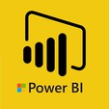
Hii,
Iam Siddhika
Welcome to Power BI Series
Part -30

Slide 2

Today Content
We focus only on the most used and important Dax Functions
I’m soo Excited.
Are you ready guys?
Meet DAX
COMMON FUNCTION CATEGORIES
3. TEXT FUNCTIONS ( FEW MORE)
UPPER LOWER SEARCH FIND

Slide 3


UPPER
The UPPER function in DAX converts all letters in a text string to uppercase.
I know it is
easy for you
Syntax
too
UPPER (<text>)
Example
Suppose we have a column named "ProductName" in the Orders Table , and we want to convert all product names to uppercase.
This DAX formula will return a new column where all letters in the "ProductName" column are converted to uppercase. For example, if the product name is "Chair", the result will be "CHAIR".

Slide 4
LOWER
The LOWER function in DAX converts all letters in a text string to lowercase
Easy ...
Syntax
LOWER(<text>)
Example
Suppose we have a column named "ProductName" in the Orders table, and we want to convert all product names to lowercase.
This DAX formula will return a new column where all letters in the "ProductName" column are converted to lowercase. For example, if the product name is "CHAIR", the result will be "chair".

Slide 5

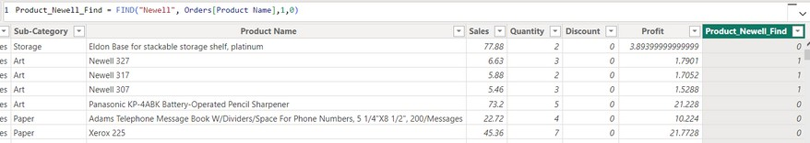

FIND
The FIND function in DAX returns the starting position of one text string within another text string. It's important to note that FIND is case-sensitive.
check this?
Syntax
FIND(<find_text>, <within_text>[, [<start_num>][,
<NotFoundValue>]])
Example
Suppose we have a column named "ProductName" in the Sales table, and we want to find the starting position of the substring "Newell" within each product name.
the DAX will return the position of the first occurrence of the substring "Newell" within each product name in the "Product Name" column of the "Orders" table. If "Newell" is found within the product name, it will return the position of its first occurrence. If "Newell" is not found, it will return 0.

Slide 6

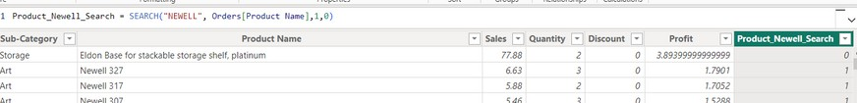
SEARCH
The SEARCH function in DAX returns the number of the character at which a specific character or text string is first found, reading left to right. Unlike FIND, SEARCH is case-insensitive and accent sensitive.
learn it?
if you're looking for "apple" in the sentence "I like apples", SEARCH will tell you it starts at position 9.
Syntax
SEARCH(<find_text>, <within_text>[, [<start_num>][,
<NotFoundValue>]])
Suppose we have a column named "ProductName" in the Orders table, and we want to search for the substring "Newell" within each product name.
Example
This DAX searches for the substring "Newell" within each value in the "Product Name" column of the "Orders" table. If "Newell" is found within a product name, the function will return the position of the first occurrence of "Newell" in that product name. If "Newell" is not found, the function will return 0. The result will be stored in a new column named "Product_Newell_Search"

Slide 7


Thank you for joining me today to learn about Part -30 of Power BI!
Remember, Learning DAX is key to unlocking the full potential of Power BI for insightful reporting and visualization.
Stay tuned for more insights and tips on Power BI in our next Series.
Follow
Siddhika Shah

